Slide 1
Wizard of Oz Prototypes
Video by Carlota Caldeira da Silva from
https://www.pexels.com/video/curtains-of-a-door-being-blown-by-wind-3881701/ (PD)

Slide 2
Learning Goals
Understand what Wizard of Oz prototypes are
Know how and when to use Wizard of Oz prototypes
Wizard of Oz Prototypes

Slide 3
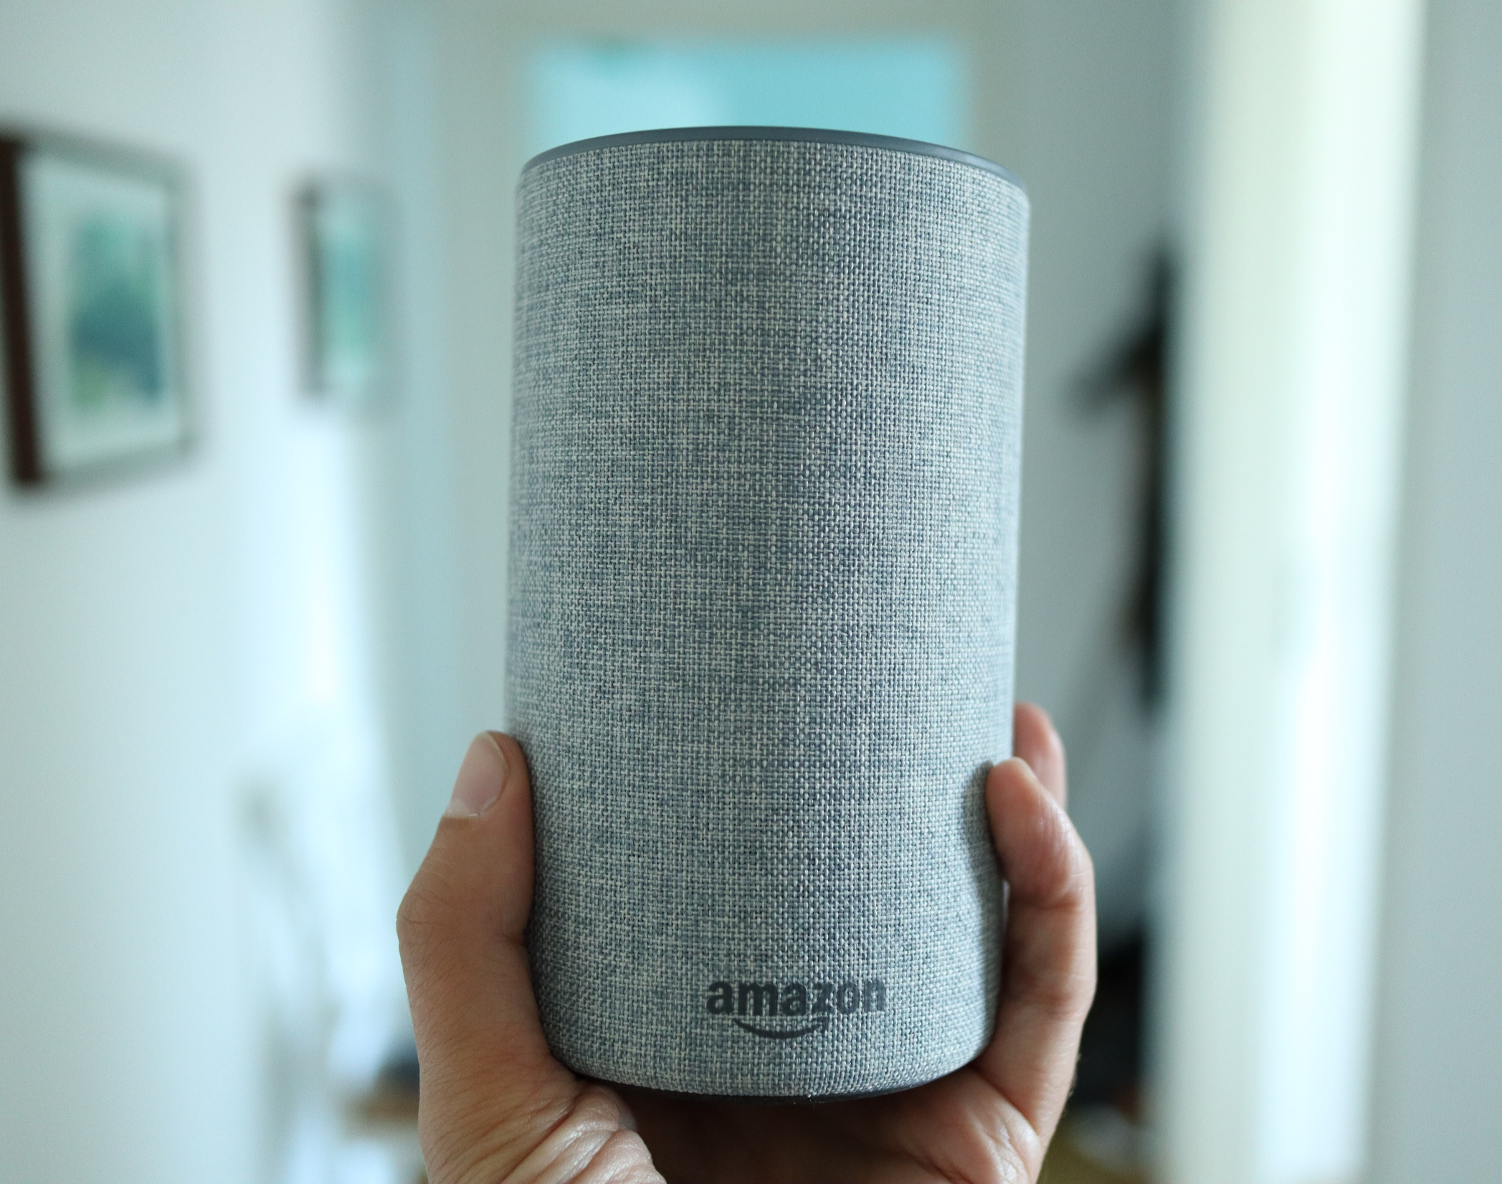
Prototyping IoT devices
How would you build a prototype?
In an hour?
In a day?
In a week?
Wizard of Oz Prototypes
Notes:
Introduced November 2014
Siri: October 2011

Slide 4
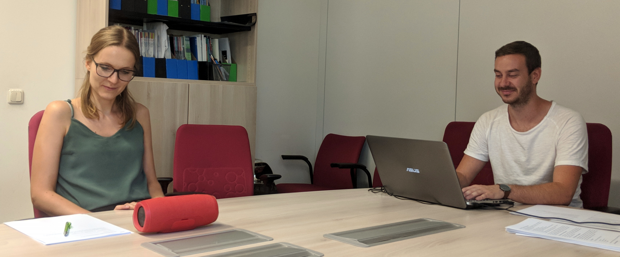
Habler, F., Schwind, V., & Henze, N. (2019). Effects of Smart Virtual Assistants' Gender and Language. In MuC.
Compare different voices and personalities
Participants got a set of tasks
Experimenter played pre-recorded sound files
Participants did not even notice that no speech recognition or reasoning was involved
Wizard of Oz Prototypes

Slide 5
Development is hard – not testing is harder
Often unclear if a system is worth the development effort
Especially true for systems requiring novel hardware or algorithms
Learning if the system is useful and the functions users want requires the system
Wizard of Oz Prototypes

Slide 6
Wizard of Oz
An invisible ‘wizard’ controlling parts of the functionality
We only implement the easy parts but leave the hard part to the human operator
Provides the user with the experience without extensive implementation effort for the prototype
Typical areas
Speech recognition
Speech synthesis
Annotation
Reasoning
Computer vision
Wizard of Oz Prototypes

Slide 7
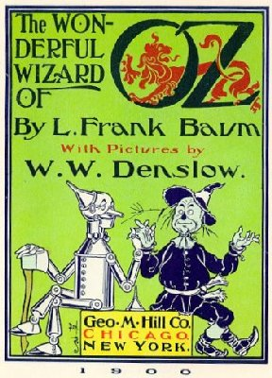
Wizard of Oz - Definition
“Wizard of Oz is a rapid-prototyping method for systems costly to build or requiring new technology. A human “Wizard” simulates the system’s intelligence and interacts with the user through a real or mock computer interface.”
“Pay no attention to that man behind the curtain ...," takes on a new meaning when the curtain is replaced by a computer terminal
Maulsby, D., Greenberg, S., & Mander, R. (1993). Prototyping an intelligent agent through Wizard of Oz. In Proceedings of the INTERACT'93 and CHI'93 conference on Human factors in computing systems.
Wizard of Oz Prototypes

Slide 8
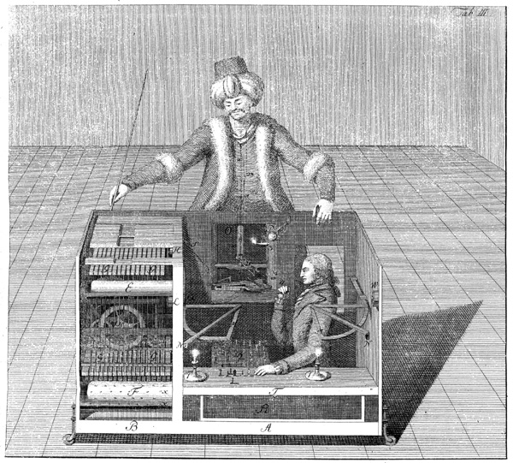
Mechanical Turk or Automaton Chess Player
Engraving from the book: Freiherr Joseph Friedrich zu Racknitz, Ueber den Schachspieler des Herrn von Kempelen, Leipzig und Dresden 1789.
Wizard of Oz Prototypes
Notes:
Developed by Wolfgang von Kempelen in the 18th century

Slide 9
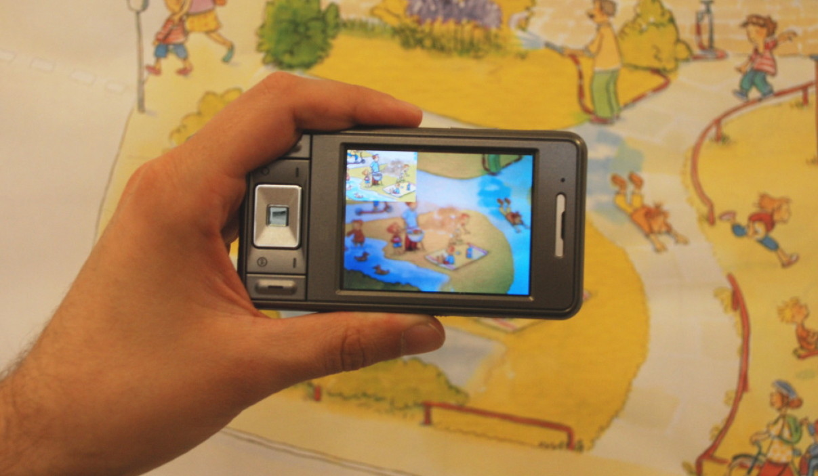
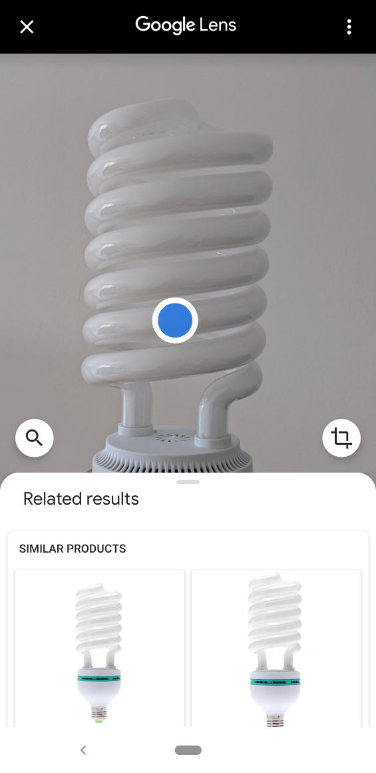
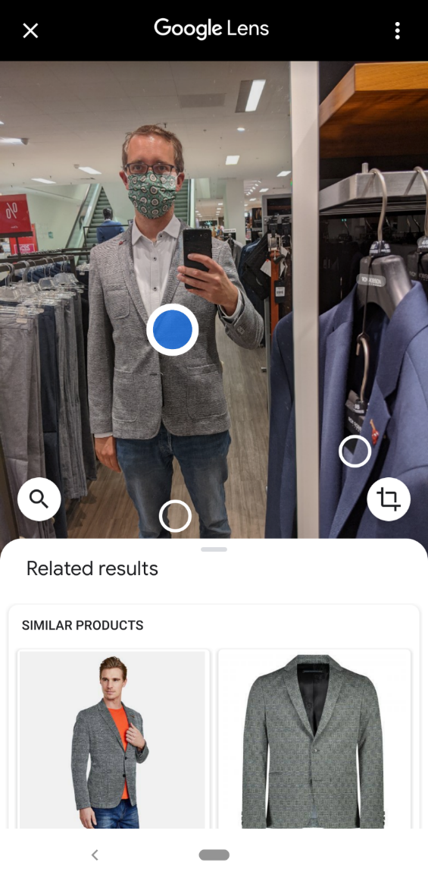
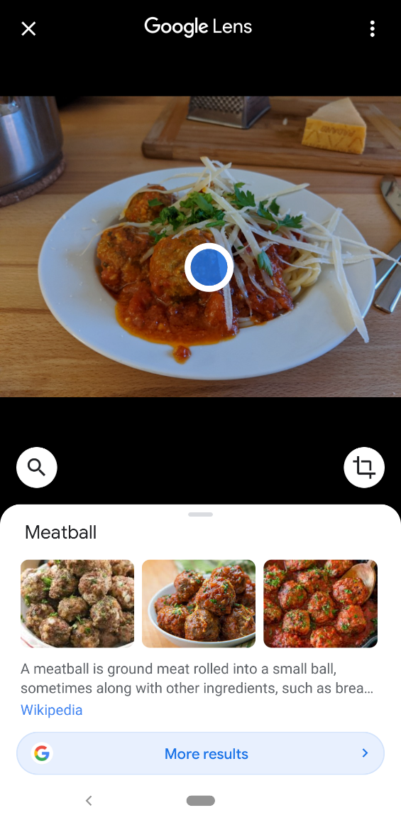
Image Recognition
Henze, N., Schinke, T., & Boll, S. (2009). What is that? object recognition from natural features on a mobile phone. In MIRW.
Wizard of Oz Prototypes

Slide 10
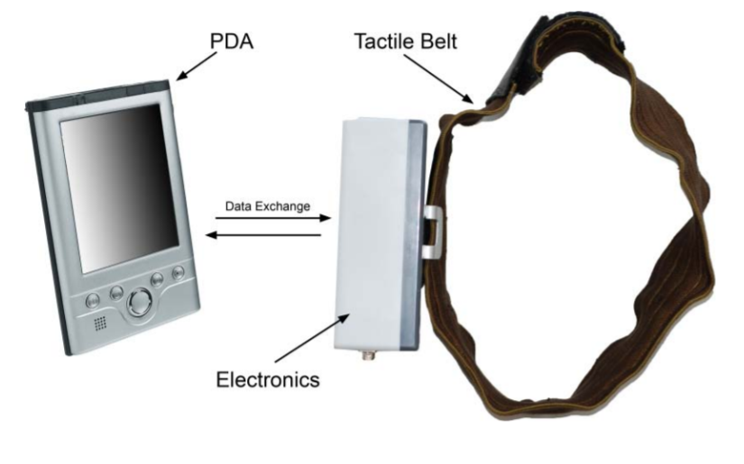
Prototyping Wearables
Wizard of Oz Prototypes

Slide 11
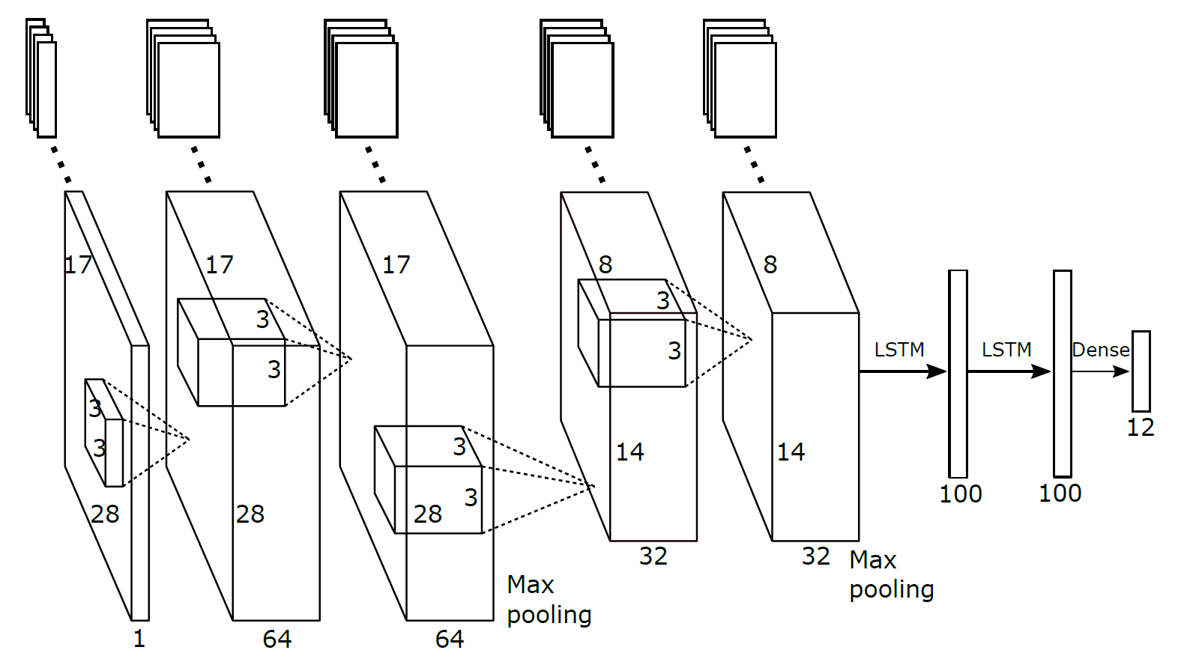
Le, H. V., Mayer, S., Weiß, M., Vogelsang, J., Weingärtner, H., & Henze, N. (2020). Shortcut Gestures for Mobile Text Editing on Fully Touch Sensitive Smartphones. In ToCHI.
Wizard of Oz Prototypes

Slide 12
A Wizard for Gesture Recognition
Assess shortcut gestures with the ‘perfect’ gesture recognizer
Participants performed the gestures as they would do with the real system
Operator monitored participants and activated the respective functions on a second device
Wizard of Oz Prototypes

Slide 13
Advantages and Disadvantages
Wizard of Oz
Implemented only the „soft“ part
Using human operators for the hard parts
Advantages
Receive early feedback
Compare with alternatives
Disadvantages
Even implementing the soft parts requires effort
Unclear if operator’s performance can ever be reached
Performance depends on the operator
Wizard of Oz Prototypes

Slide 14
License
This file is licensed under the Creative Commons Attribution-Share Alike 4.0 (CC BY-SA) license:
https://creativecommons.org/licenses/by-sa/4.0
Attribution: Niels Henze
For more content see: https://hci-lecture.de

